Slide 1
Unit II: Integrated Circuit Technology
Integrated Circuit Technology :
Logic Families

Slide 2
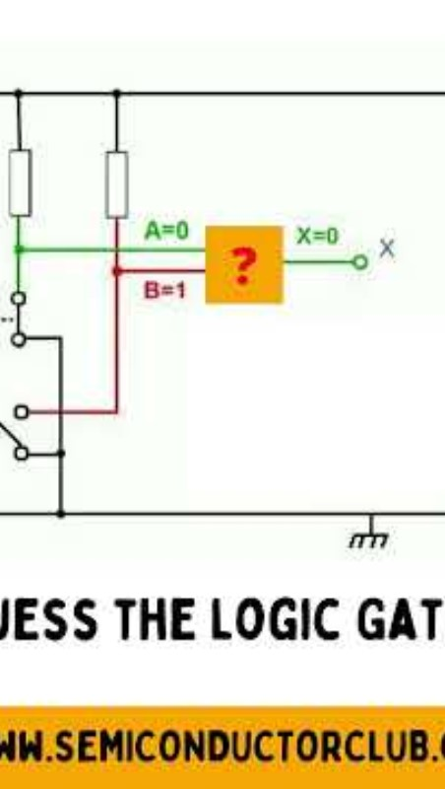
Let's Check our knowledge

Slide 3

Introduction
What is logic families?
  It is a group of compatible ICs with the same logic levels & supply voltages for performing various logic functions have been fabricated using a specific circuit configuration
Significance of logic families
  First and most important is simplicity in design
  It reduces the complexity in design
  Provide compatibility in digital circuit
  Easy to expand

Slide 4
Classification of Logic Families
Logic Families
Unipolar
Bipolar
PMOS
NMOS
CMOS
Saturated
Non Saturated
RTL
DTL
TTL
Schottkey TTL
ECL

Slide 5
ICs are integrated using following integration techniques
SSI (upto 12 logic gates)
MSI (12 to 99 logic gates)
LSI (100 to 9999 logic gates)
VLSI (10,000 to 99999 logic gates)
ULSI (> 100,000 logic gates)
September 18, 2019
Digital Electronics MITCOE
5

Slide 6
Characteristics of Digital ICs
Speed of Operation
Power Dissipation
Figure of Merit
Fan Out
Fan In
Current and Voltage Parameters
Noise Immunity
Power Supply Requirements
Operating Temperature

Slide 7


Voltage & Current
For a High-state gate driving a second gate, we define:
  V_{OH} (min), high-level output voltage, the minimum voltage level that a logic gate will produce as a logic 1 output.
  V_{IH} (min), high-level input voltage, the minimum voltage level that a logic gate will recognize as a logic 1 input. Voltage below this level will not be accepted as high.
  I_{OH}, high-level output current, current that flows from an output in the logic 1 state under specified load conditions.
  I_{IH}, high-level input current, current that flows into an input when a
logic 1 voltage is applied to that input.
^{I} OH ^{I} IH
Test setup for measuring values
^{V}OH
^{V}IH
Ground

Slide 8


Voltage & Current
For a Low-state gate driving a second gate, we define:
  V_{OL} (max), low-level output voltage, the maximum voltage level that a logic gate will produce as a logic 0 output.
  V_{IL} (max), low-level input voltage, the maximum voltage level that a logic
gate will recognize as a logic 0 input. Voltage above this value will not be accepted as low.
  I_{OL} , low-level output current, current that flows from an output in the
logic 0 state under specified load conditions.
  I_{IL} , low-level input current, current that flows into an input when a logic 0 voltage is applied to that input.
Inputs are
^{I} OL ^{I} IL
connected to V_{cc}
instead of
Ground
^{V} OL
^{V} IL
Ground

Slide 9
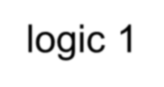



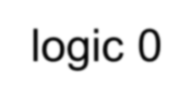
Electrical Characteristics
Important characteristics are:
  V_{OHmin} min value of output recognized as a ‘1’
  V_{IHmin} min value input recognized as a ‘1’
  V_{ILmax} max value of input recognized as a ‘0’
  V_{OLmax} max value of output recognized as a ‘0’
  Values outside the given range are not allowed.
logic 1
indeterminate input voltage
logic 0

Slide 10
Logic Level & Voltage Range
Typical acceptable voltage ranges for positive logic 1 and logic 0 are shown below
A logic gate with an input at a voltage level within the ‘indeterminate’ range will produce an unpredictable output level.
5.0V
5.0V
2.4V
2.0V
Logic 1 40µA
Indeterminate
Logic 0 ^{1.6 mA}
Logic 1 400µA
Indeterminate
Logic 0 16 mA
0.8V
0V
0.4V
0V
TTL INPUT
TTL OUTPUT
11

Slide 11
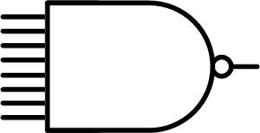
Fan-In
Number of input signals to a gate
  Not an electrical property
  Function of the manufacturing process
NAND gate with a Fan-in of 8

Slide 12
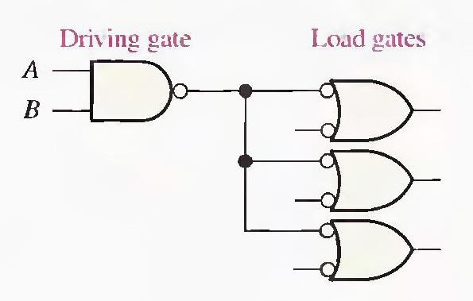
Fan out
Also known as loading factor
Defined as the maximum number of logic inputs that an output can drive reliably
A logic circuit that specify to have 10 fan out can drive 10 logic inputs. The maximum number of standard logic inputs that an output can drive reliably.
Related to the current parameters (both in high and
low states.)
For TTL (10),CMOS(50)
Digital Electronics MITCOE

Slide 13


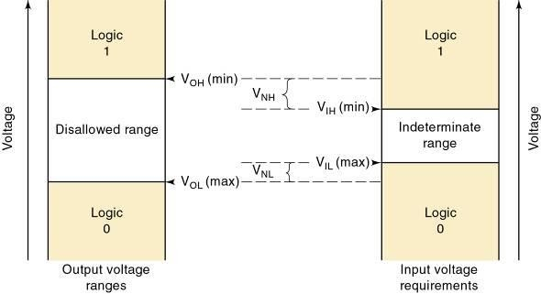
Noise Margin
Noise immunity refers to the circuit’s ability to tolerate noise without changes in output voltage.
– A quantitative measure is called noise margin.
High-state noise margin: Low-state noise margin:

Slide 14
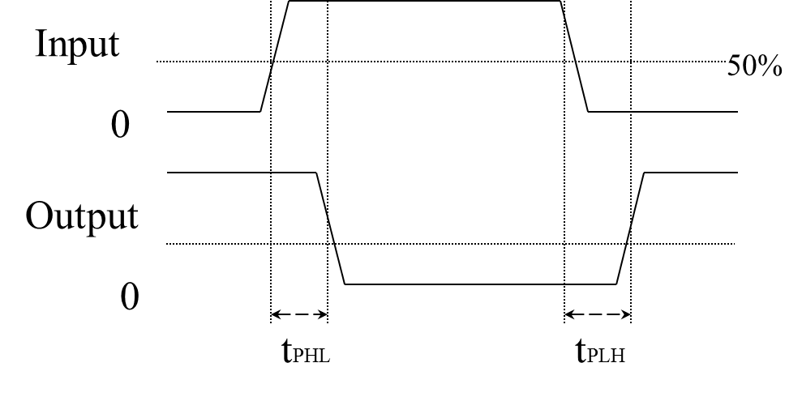
Speed: Propagation Delay
The propagation delay (tpd) which is the time taken for a change at the input to appear at the output
A logic gate always takes some time to change states
t_{PLH} is the delay time before output changes from low to high t_{PHL} is the delay time before output changes from high to low both t_{PLH} & t_{PHL} are measured between the 50% points on the input and output transitions
Digital Electronics WPU

Slide 15
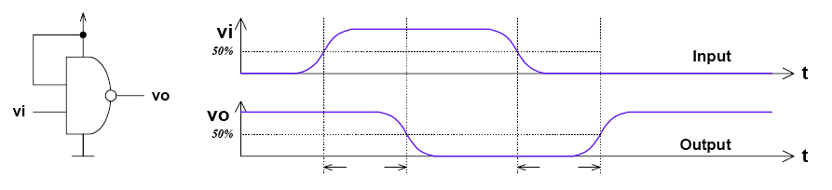
Characteristics of Digital ICs
Speed of Operation/ Propagation Delay time
TPD,HL–input-to-output propagation delay from HI to LO output
TPD,LH–input-to-output propagation delay from LO to HI output
Propagation delay is average of TPD, HL and TPD, LH

Slide 16
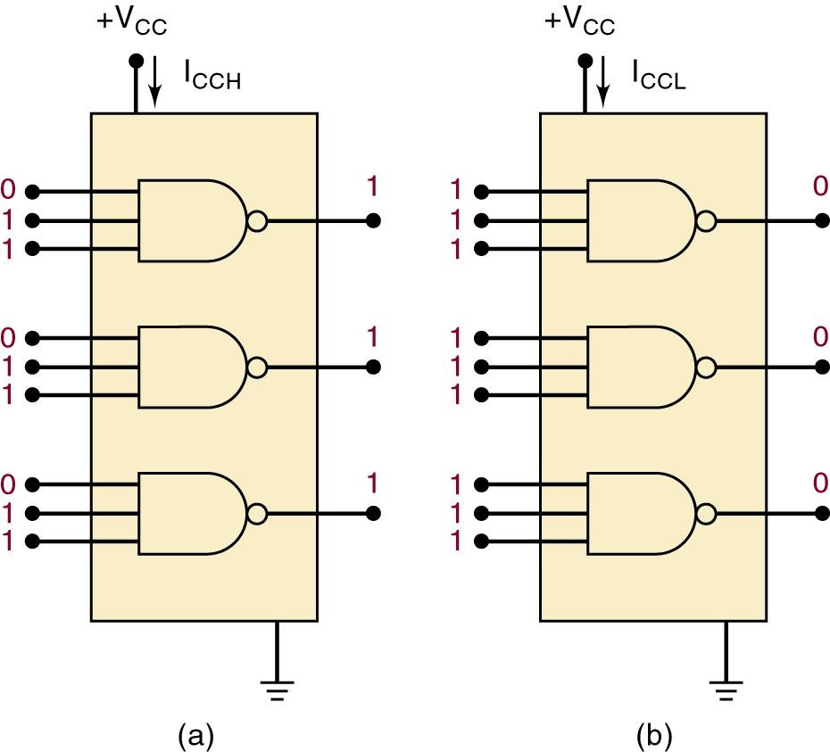
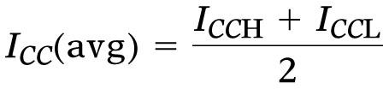
Digital IC Terminology – Power Requirements
The amount of power an IC requires is determined by the current, I_{CC}
(or I_{DD}) it draws from the supply.
Actual power is the product I_{CC} x V_{CC} (I_{DD} x V_{DD} ).
In some logic circuits, average current is computed based on the assumption that gate
outputs are LOW half the time and HIGH half the time.

Slide 17
Power Dissipation
Static
  I²R losses due to passive components, no input signal
Dynamic
  I²R losses due to charging and discharging capacitances through resistances, due to input signal

Slide 18



Speed-Power Product (Figure of Merit)
Speed (propagation delay) and power consumption are the two most important performance parameters of a digital IC.
A simple means for measuring and comparing the overall performance of an IC family is the speed-power product (the smaller, the better).
For example, an IC has
  an average propagation delay of 10 ns
  an average power dissipation of 5 mW
  the speed-power product = (10 ns) x (5 mW)
= 50 picoJoules (pJ)

Slide 19
Characteristics of Digital ICs
Power Supply Requirements
The required power requirement for the logic family
Should be as minimum as possible
Operating Temperature
-55 C to +125 C – Military and space applications
0 C to+70C – Commercial and Industrial Applications.

Slide 20
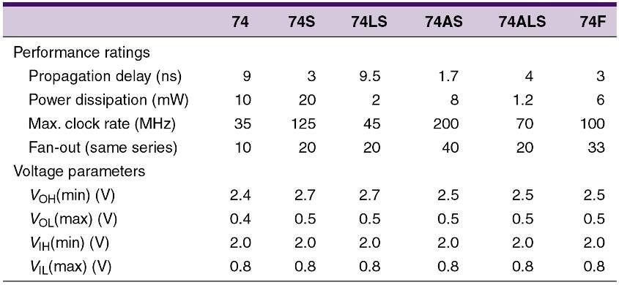
Typical TTL series characteristics.

Slide 21
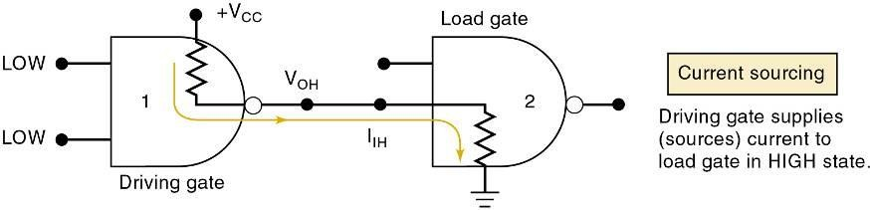
Current Sourcing/Sinking
Current-sourcing action.
  When the output of gate 1 is HIGH, it supplies current I_{IH} to the input of gate 2.
    Which acts essentially as a resistance to ground.
  The output of gate 1 is acting as a source of current for the gate 2 input.

Slide 22
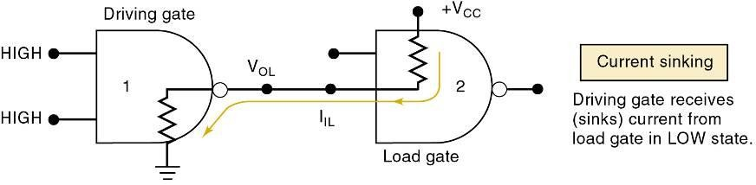
Current Sourcing/Sinking
Current-sinking action.
  Input circuitry of gate 2 is represented as a resistance tied to +V_{CC}
—the positive terminal of a power supply.
  When gate 1 output goes LOW, current will flow from the input circuit of gate 2 back through the output resistance of gate 1, to ground.
    Circuit output that drives the input of gate 2 must be able to sink
a current, I_{IL} , coming from that input.

Slide 23
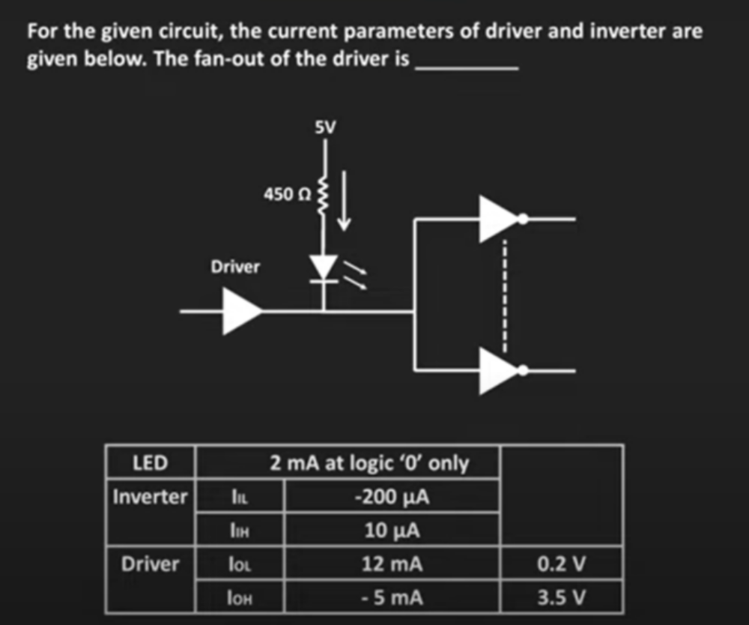
Quiz#1

Slide 24
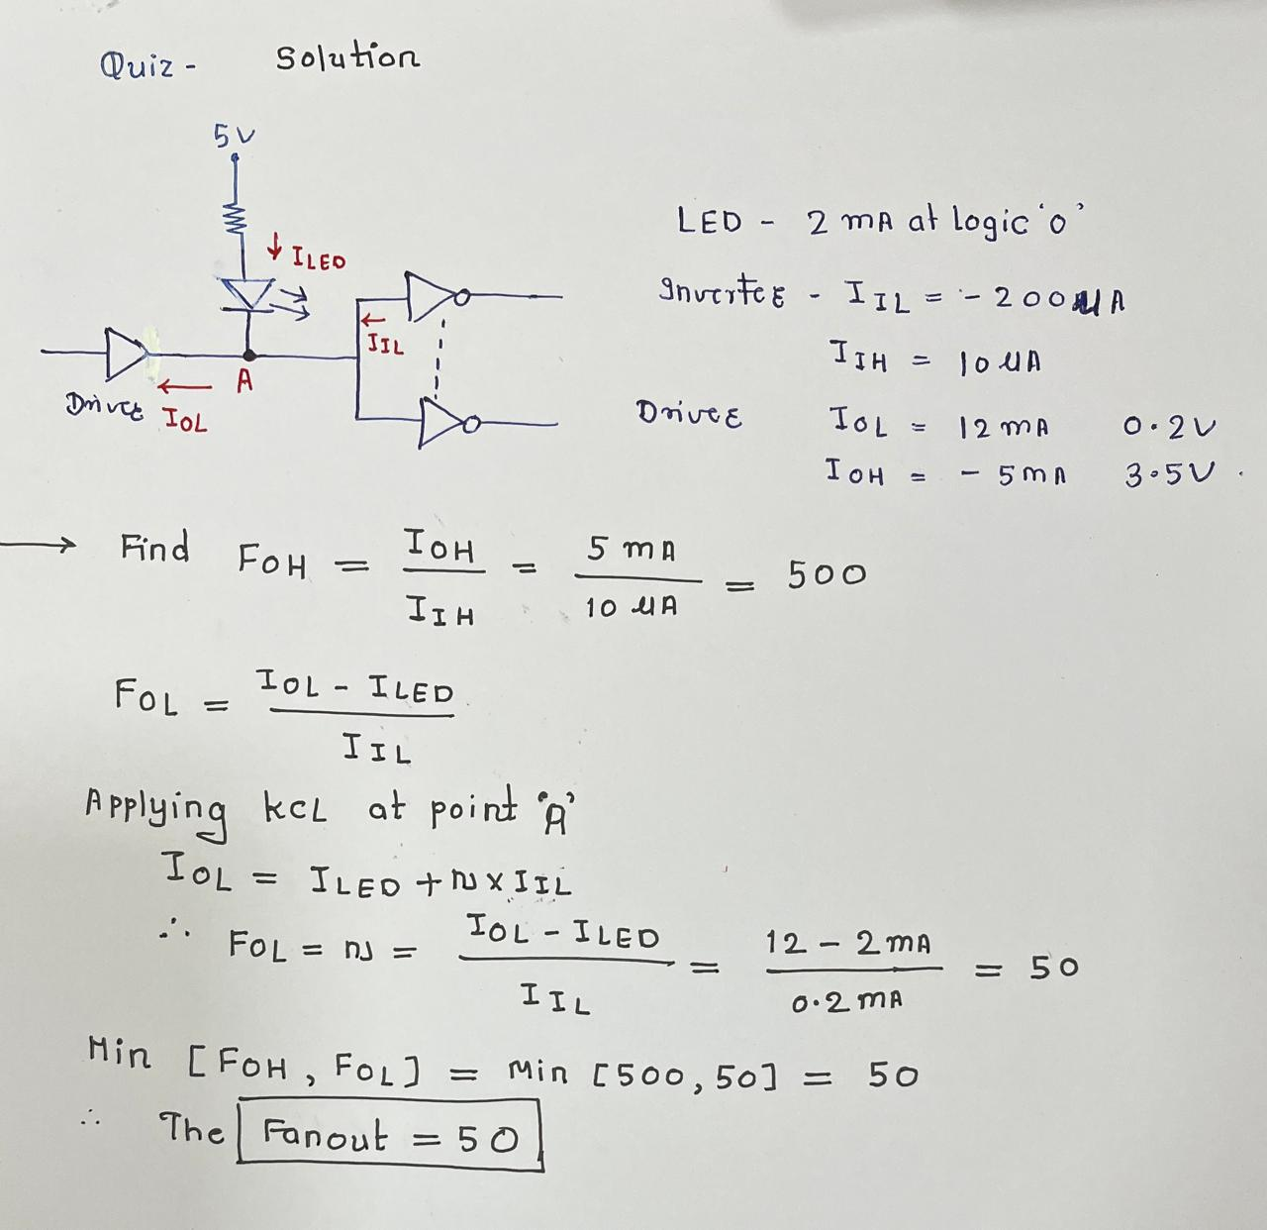
Quiz#1 solution

Slide 25
Quiz#2
All the logic gates shown below have a propagation delay of 20 ns. For time t < 0, A = C = 0 and B = 1. At time t = 0, all the inputs flip (A = C = 1 and B = 0) and remain in that state. For t > 0, the output Z = 1 for the duration (in ns) of ________
A
B
C
AND
EXOR
NOT
Z

Slide 26
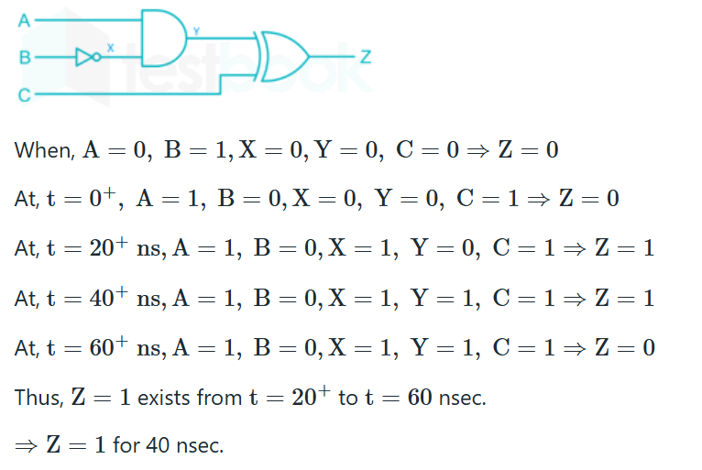
Quiz 2# Solution

Slide 27

Quiz#3
The logic circuit with input signal TEST is shown below. All the gates in the circuit have identical non-zero delay. The signal TEST which was at logic LOW is switched to logic HIGH and maintained at logic HIGH. The output
stays HIGH throughout
B) stays LOW throughout
C) pulses from HIGH to LOW to HIGH
D) pulses from LOW to HIGH to LOW
Ans: C

Slide 28
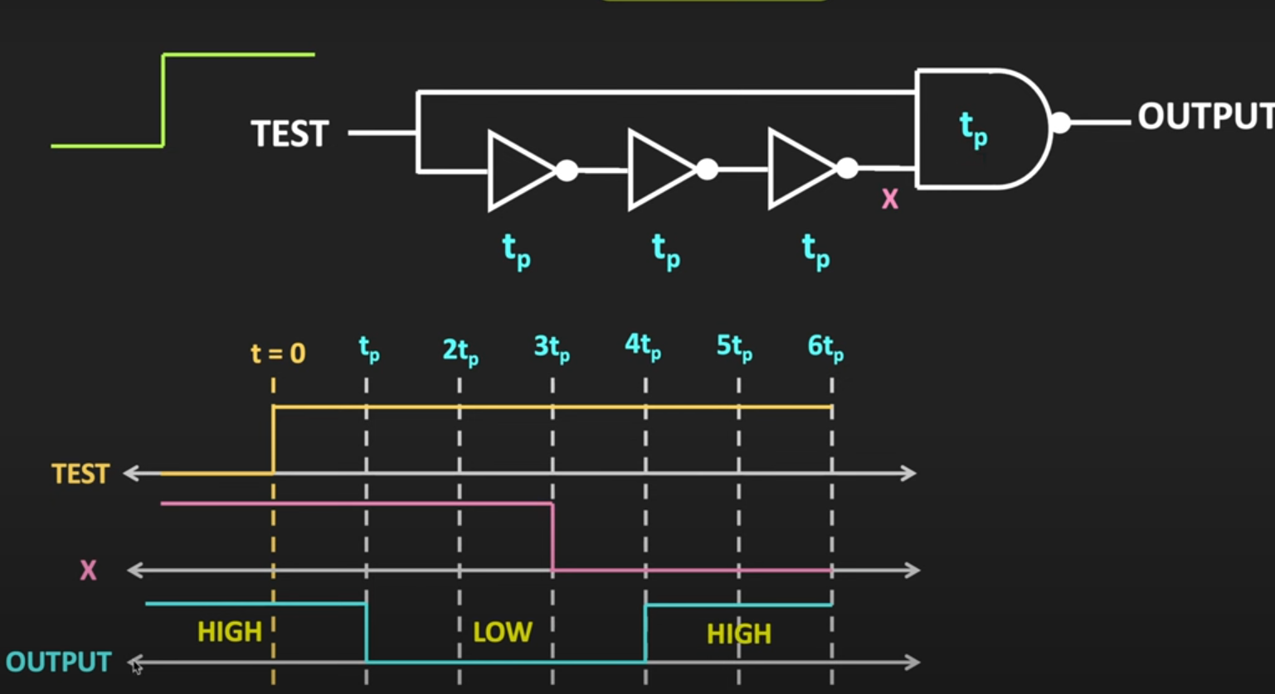
Quiz # 3 Solution

Slide 29
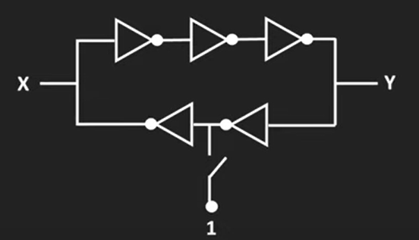
Quiz#4
In the given circuit, the switch is momentarily closed and then opened.
Assuming the logic gates to have equal non-zero delay, at steady state, the logic states of X and Y are
A) X is latched, Y toggles continuously
B) Both X and Y are latched
C) Y is latched, X toggles continuously
D) Both X and Y toggle continuously
Ans: D

Slide 30
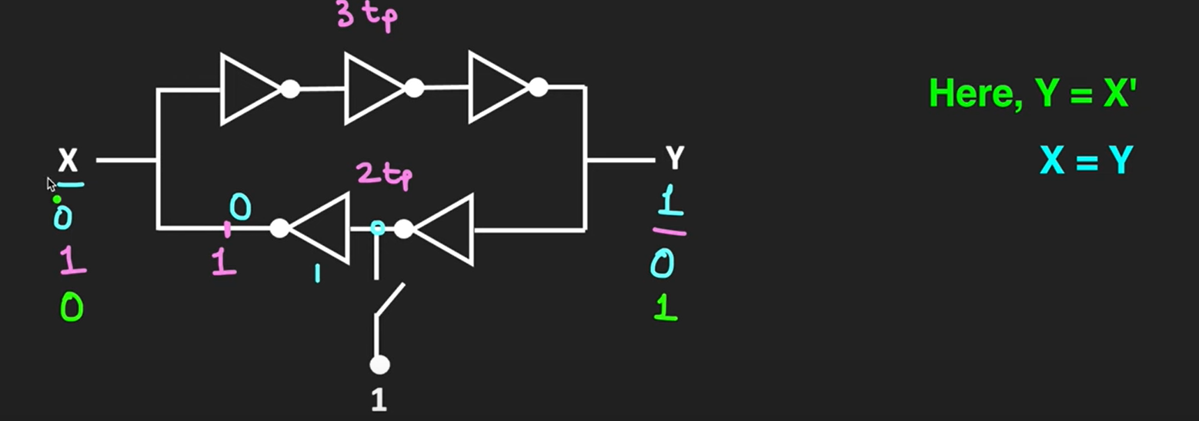
Quiz#4 Solution

Slide 31
https://www.electronics-tutorials.ws/transistor/tran_4.html

Slide 32
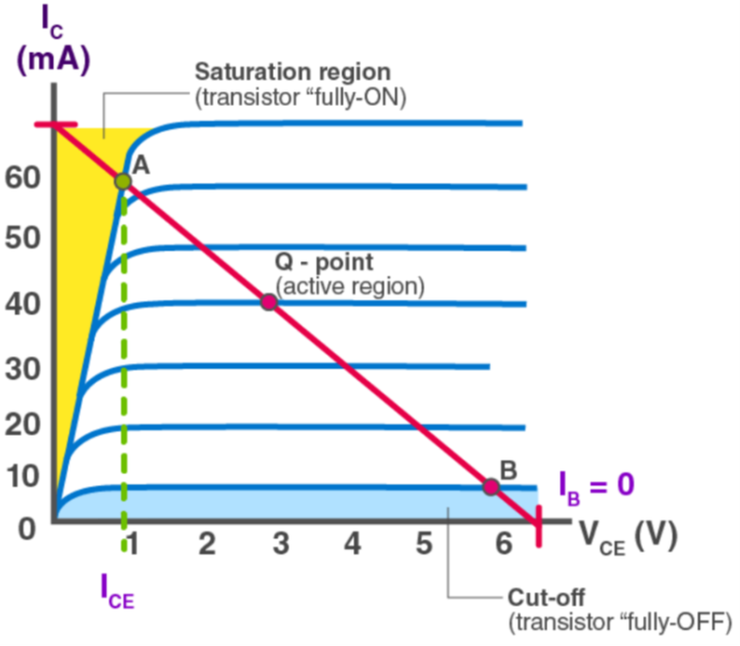

Slide 33
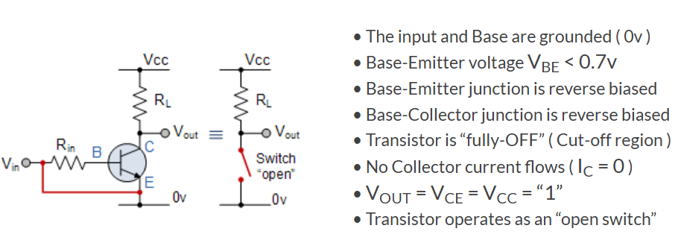
Cut off

Slide 34
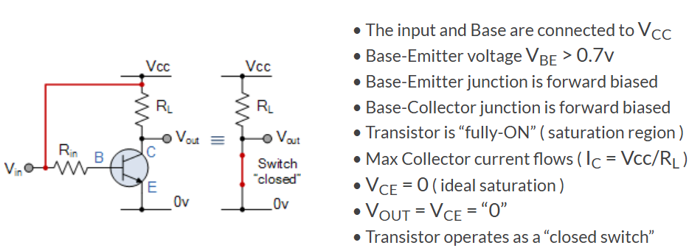
Saturation Characteristics

Slide 35
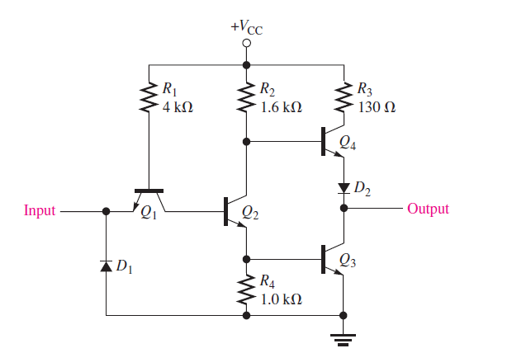
TTL Inverter

Slide 36
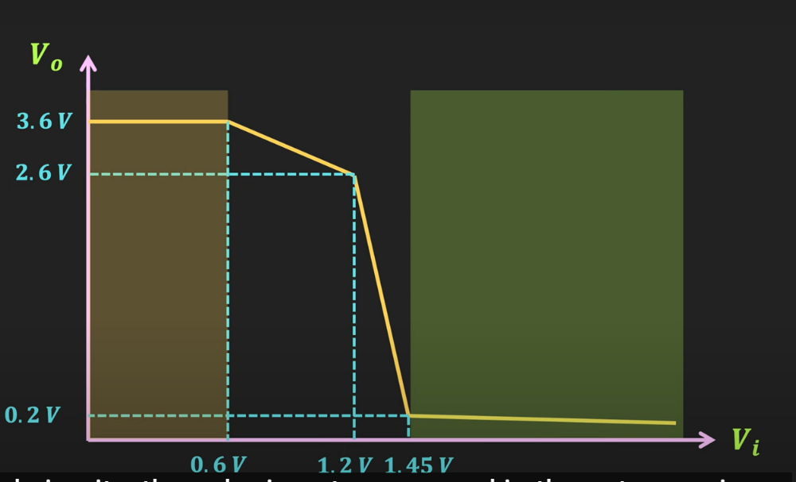
TTL Inverter Voltage Transfer Characteristics

Slide 37
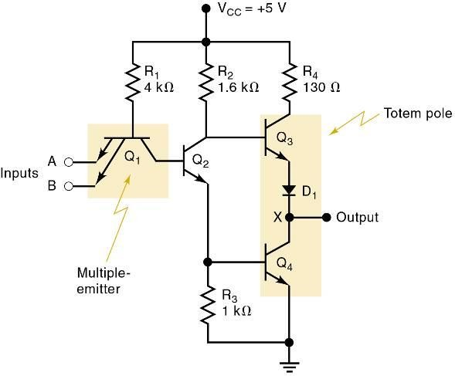
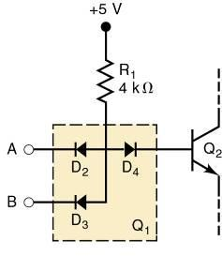

Logic Family
The basic TTL logic circuit is the NAND gate.
Diode equivalent for Q₁ .
Basic TTL
NAND gate.

Slide 38
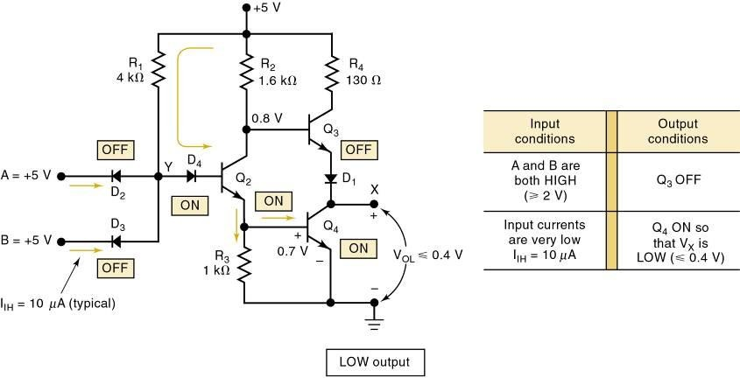
TTL NAND gate LOW output
Vce(sat)= 0.2v

Slide 39
TTL Circuit Operation
+V_{cc}
4K R₁
1.6K R₂
130
R₃
A | B | ^{I}CQ1 | Q₁ | Q₂ | Q₃ | Q₄ | Y O/P
0 | 0 | + | ON | OFF | OFF | ON | 1
0 | 1 | + | ON | OFF | OFF | ON | 1
1 | 0 | + | ON | OFF | OFF | ON | 1
1 | 1 | — | OFF | ON | ON | OFF | 0
Q ₄
D ₃
Q ₂
A B
Y O/P
Q
1 I
CQ1
Q ₃
D₁
D₂
1K R₄
Table explaining the operation of the TTL NAND gate circuit
A standard TTL NAND gate circuit

Slide 40
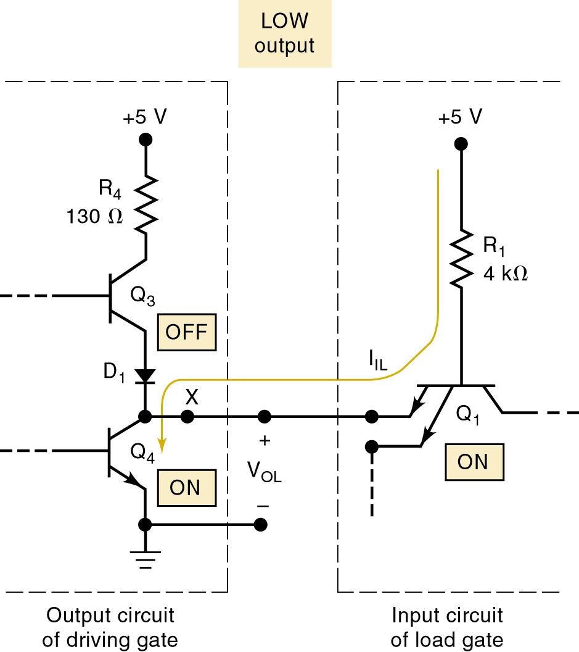
A TTL output acts as a current sink in the LOW state because it receives current from the input of the gate that it is driving.
Transistor Q₄ of the driving gate is on and essentially “shorts” point X to ground.
LOW voltage at X forward- biases the emitter–base junction of Q₁ & current flows back through Q₄.

Slide 41
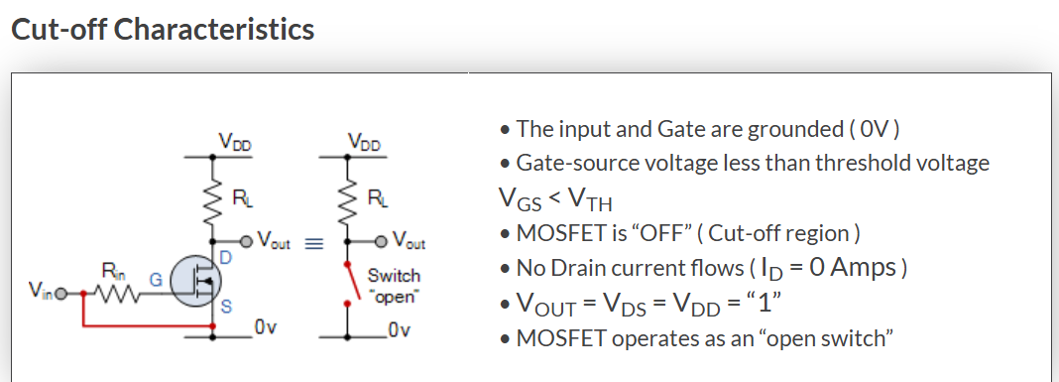
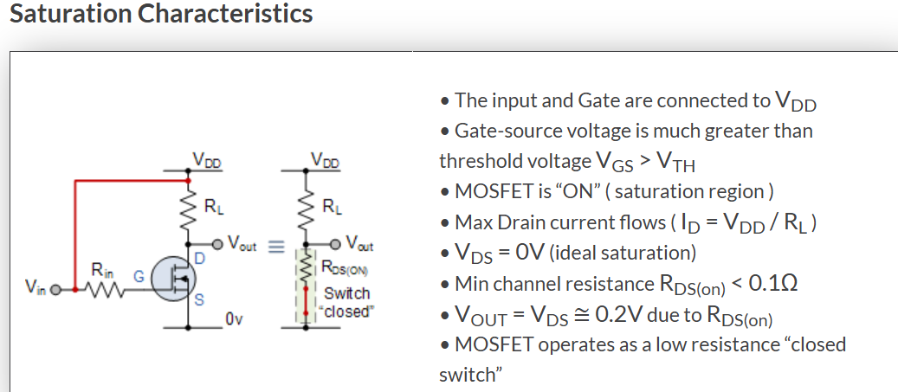

Slide 42
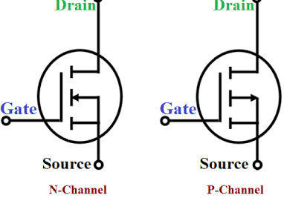
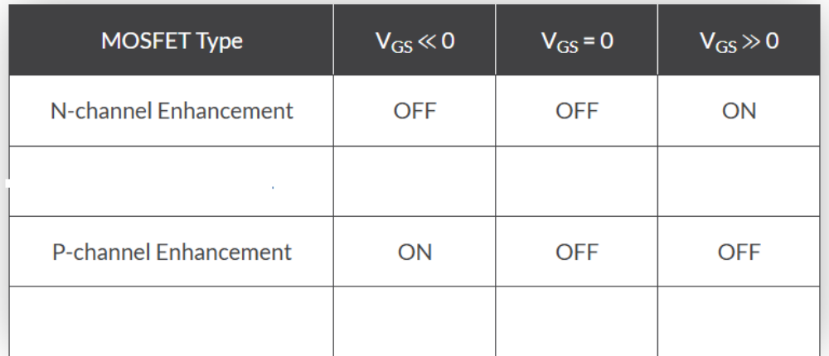

Slide 43
MOS Circuit Operation
+V_{DD}
S
Q₁
D
O/P
I / P | Q₁ | Q₂ | O / P
0 | O N | O F F | 1
1 | O F F | O N | 0
D
Q
I/P
2
S
Table explaining the operation of
the CMOS inverter circuit
A CMOS inverter circuit

Slide 44
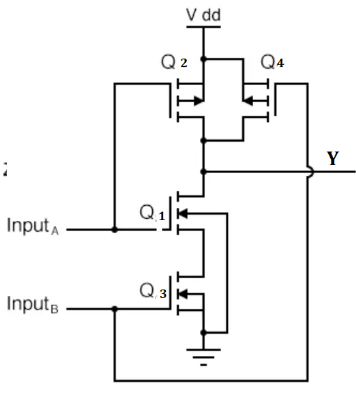
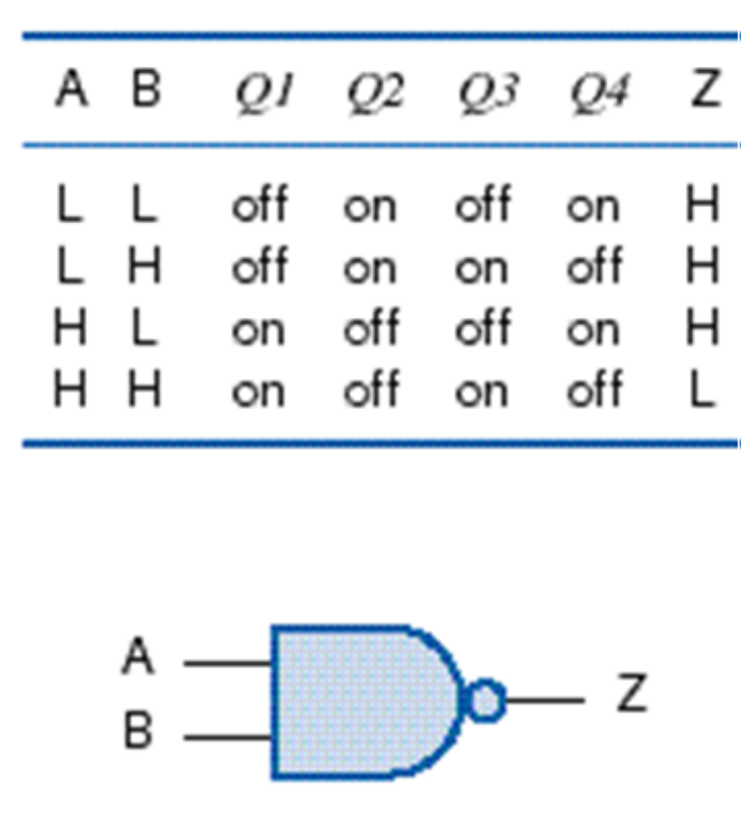
CMOS NAND Gates
P channel
Use 2n transistors for n-input gate

Slide 45
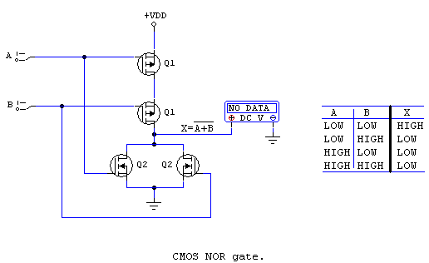
CMOS NOR Gate

Slide 46
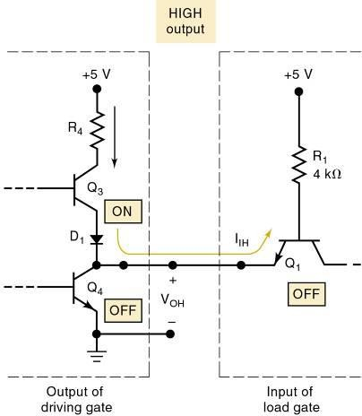
A TTL output acts as a current source in the HIGH state—a small reverse-bias leakage current.
Transistor Q₃ is supplying the
input current (I_{IH}) required by Q₁ of the load gate.
Q₃ is often called the current-
sourcing or pull-up transistor.
In more modern TTL series, the pull-up circuit is made up of two transistors.

Slide 47
Open Collector/Open Drain Outputs
One solution to the problem of sharing a common wire among gates is to remove the active pull-up transistor from each gate’s output circuit.
– In this way, none of the gates will ever try to assert
a logic HIGH.

Slide 48
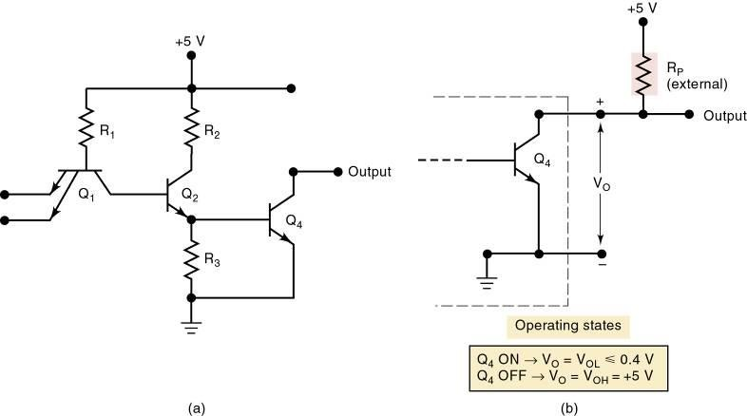
Open Collector/Open Drain Outputs
TTL outputs modified this way are called open-collector outputs.
CMOS outputs modified this way
are called open-drain outputs.

Slide 49

Quiz
The circuit diagram of standard TTL NOT gate is shown below. If Vi = 2.5V, then the mode of operations of transistors will be
D
A) Q1: Reverse Active, Q2: Normal Active, Q3: cut-off, Q4: saturation
B) Q1: Normal Active, Q2: Normal Active, Q3: cut-off, Q4: saturation
C) Q1: Normal Active, Q2: Saturation, Q3: saturation, Q4: cut-off
D) Q1: Reverse Active, Q2: Saturation, Q3: cut-off, Q4: saturation

Slide 50
IC Interfacing
Interfacing means connecting output(s) of one circuit/system to input(s) of another circuit/system.
The simplest and most desirable interface circuit between a driver and a load is a direct connection.
– Often a direct connection cannot be made due to
a difference in electrical characteristics.
An interface circuit is connected between the driver and the load, to condition the driver output signal so it is compatible with requirements of the load.
Digital Electronics MITCOE

Slide 51
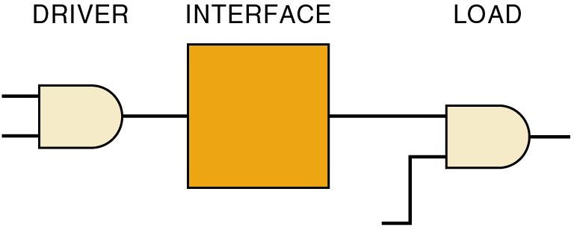
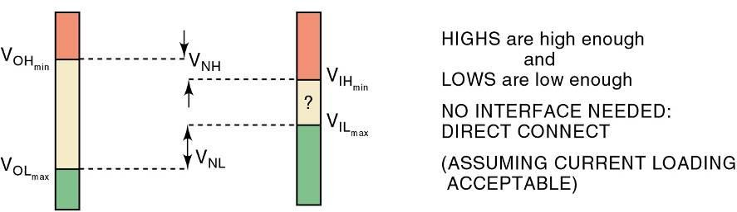
IC Interfacing

Slide 52
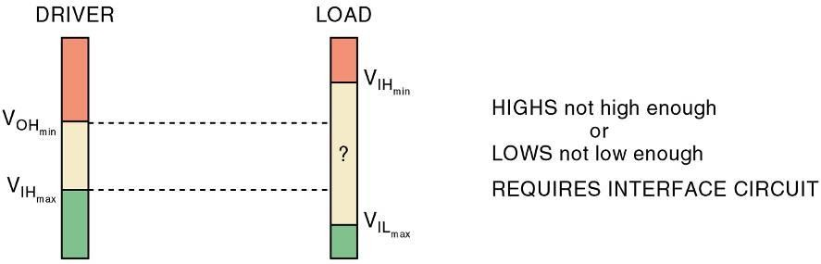
IC Interfacing

Slide 53
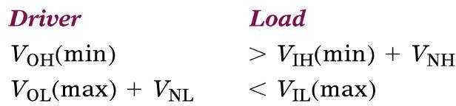
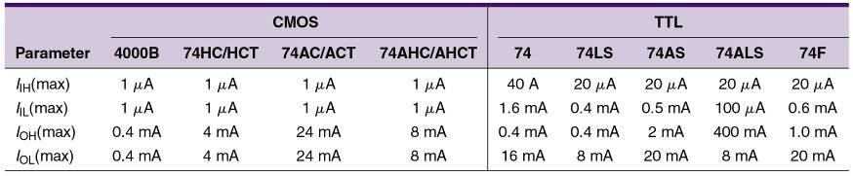
Logic devices will be voltage-compatible, and no interface
will be necessary under the following circumstances:
Nominal values for different families/series of digital devices.

Slide 54
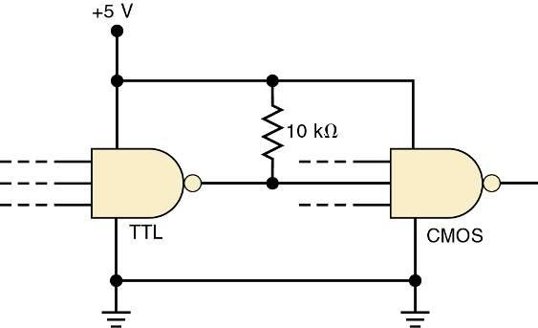
External pull-up resistor
is used when TTL drives CMOS.

Slide 55
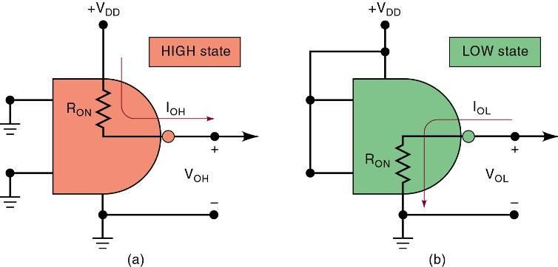
Equivalent CMOS output circuits for both logic states.

Slide 56
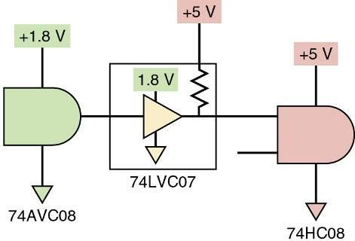
A substantial shift in voltage because driver & load operate on different supply voltages requires a voltage-level translator interface circuit.
The simplest way to accomplish this is with a buffer that has an open drain—with
a pull-up resistor.

Slide 57
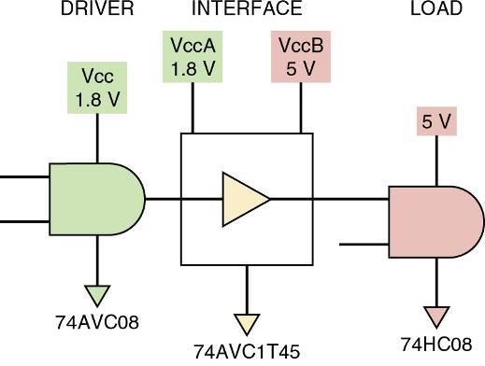
A substantial shift in voltage because driver & load operate on different supply voltages requires a voltage-level translator interface circuit.
Another solution is a dual-supply-level
translator circuit using two different supply voltages, one each for inputs & outputs, translating between the two levels.
Digital Electronics MITCOE

Slide 58
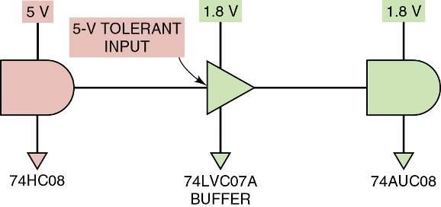
A substantial shift in voltage because driver & load operate on different supply voltages
requires a voltage-level translator interface _{circuit.}Another common solution is an interface using a
buffer from a series that can withstand higher input.
A low-voltage series with 5-V tolerant inputs
as an interface.

Slide 59
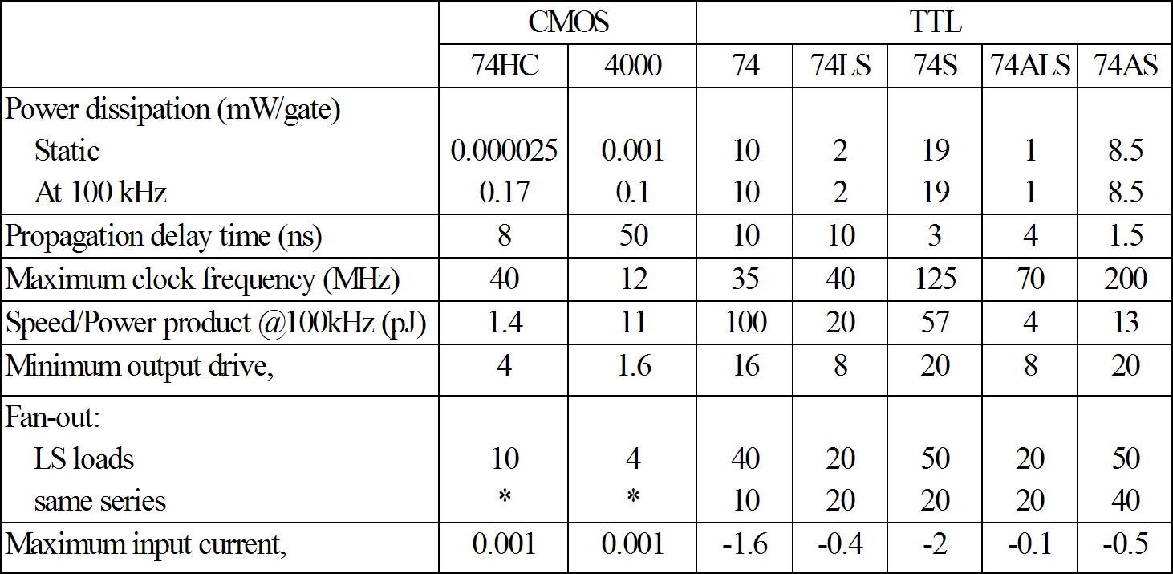
Comparison of Logic Families

Slide 60
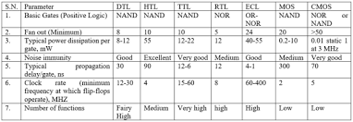
Comparison of Logic Families

Slide 61
References
Switching Circuit and Logic Design by Prof. Indranil Sengupta, IIT KGP
Modern digital Electronics by R P Jain
NPTEL VIDEO by Dr. Amitava Dasgupta, IITM
Logic Families by Dr. Basem Elhalawany
Logic Gates and Family by Dr. A. P. VAJPEYI, IITG

Slide 62
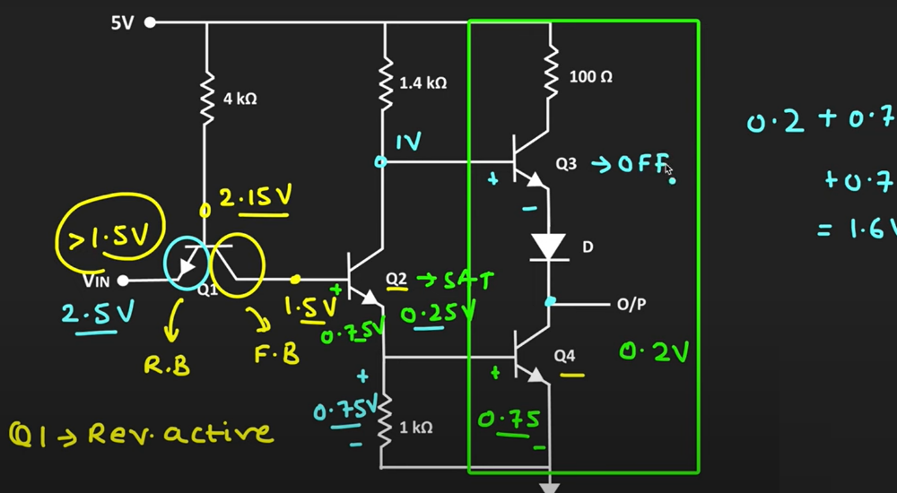
Quiz Solutions

